Slide 1


51Talk AI Training Camp Unit one - English

Slide 2





Main Content
Opening Remarks
Get Your Tools Ready
"Learn to Speak"
This Week's Homework

Slide 3


Opening Ceremony Address

Slide 4



Why Learn Collectively?
From: Those who arrive first are teachers
To: When three people walk together, one is my teacher. Exploration, emergence

Slide 5


Old Cannon and Young Calf, Each with Advantages
Old Cannon: Understands Management, Understands Business, Knows How to Lead
Young Calf: No Path Dependence, Daring to Innovate
Enemies of the Young Calf: Not enough understanding of the business, does not see themselves as a leader
Enemies of the Old Cannon: Cannot bend down, cannot roll up sleeves, cannot let go of face

Slide 6

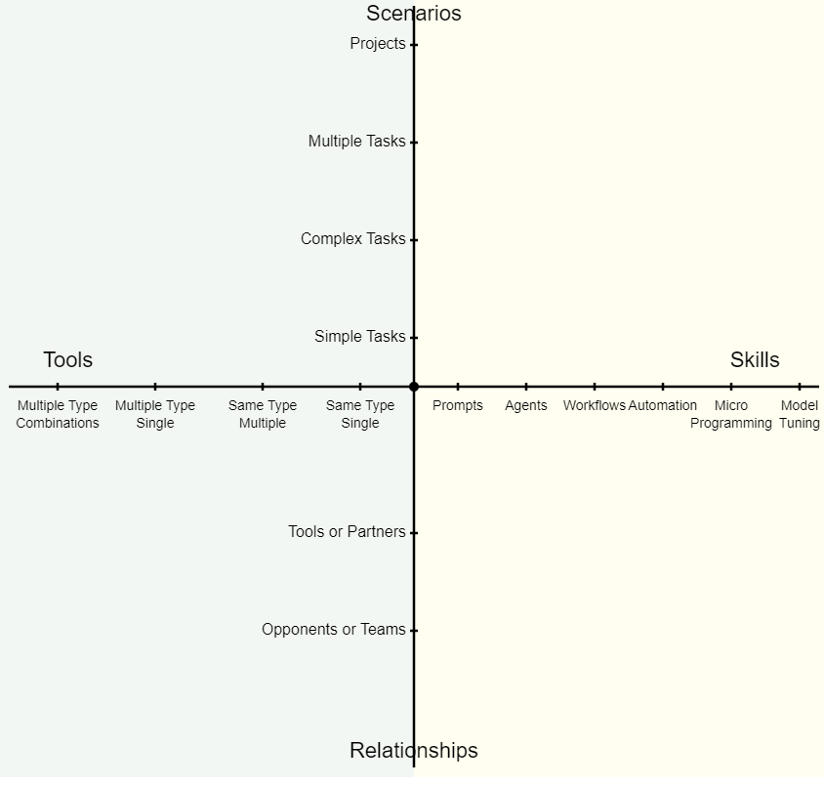
Building an (Grassroots) AI Worldview

Slide 7



3 Essential Abilities for Learning AI
Patience for Reading
Confidence for Hands-on
Courage to Ask Questions
Patiently reading the documentation and following the step-by-step guide is an essential and efficient self-learning ability.
Don't be afraid to roll up your sleeves and try out new tools - experimenting here and there is the fastest way to get up to speed.
Don't worry about saving face, ask AI, classmates, or teaching assistants when you don't understand something.

Slide 8

Training and practice lead the way, personal cultivation is key, Learning by doing

Slide 9

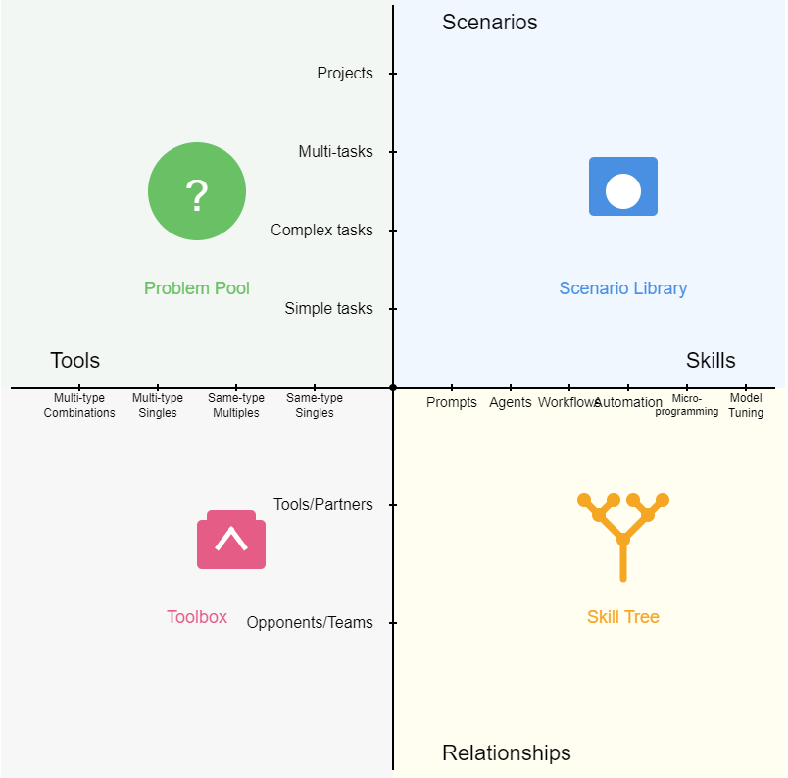
Our Path, Our Work

Slide 10

2 months later, you were carried out of the combat training camp
What happened?

Slide 11


"British engineers invented the tank German military strategists invented blitzkrieg"
Scenario and relationship are two axes, each person's own home field

Slide 12

Get Ready with the Tools

Slide 13

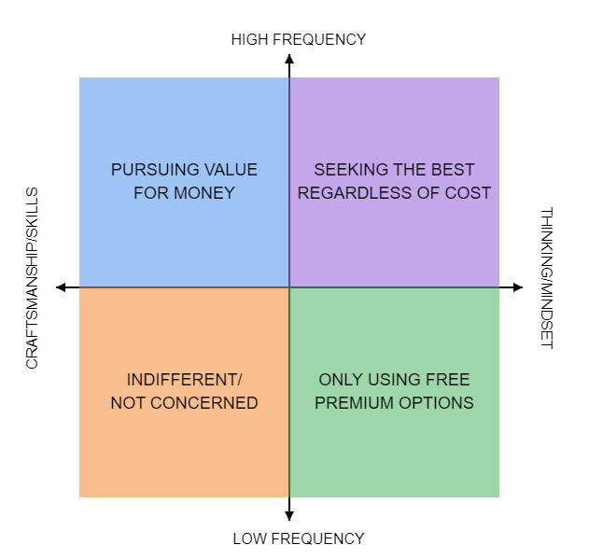
So Many Tools, How to Choose? Which Ones Are Worth Paying For?
For knowledge work, a small difference can make a big impact.
An 80-85% improvement is an investment, not just a purchase.
Understanding the boundaries of AI capabilities determines our judgment and imagination.
When designing tactics, a general must consider "what are the most advanced deployable weapons?"

Slide 14







Top 4+2 Global Leaders in Conversational AI
Claude 3.7 Sonnet
ChatGPT Series
Grok 3
All-rounder champion, unbeatable except on the web
Comprehensive functionality, in-depth research
Free, fast, in-depth research
Gemini 2.5
Perplexity
NotebookLM
Best appetite, biggest appetite
Most professional intelligent search
Best personal knowledge base

Slide 15






Stay Up-to-Date with the Capabilities of Cutting-Edge Models
SVG Coding Capabilities
ChatGPT's Deep Thinking and Research Capabilities
Grok 3's Deep Thinking Capabilities
Powerful ability to transform code into visual elements
More innovative ways of thinking
Impressive dialogue and in-depth research abilities
Gemini's Oral and Appetite Capabilities
Perplexity's Deep Search Capabilities
NotebookLM's Knowledge Base Capabilities
Powerful speech, text, and video processing abilities
Professional intelligent search experience
Personalized knowledge integration and management

Slide 16


Small Exercise

Slide 17
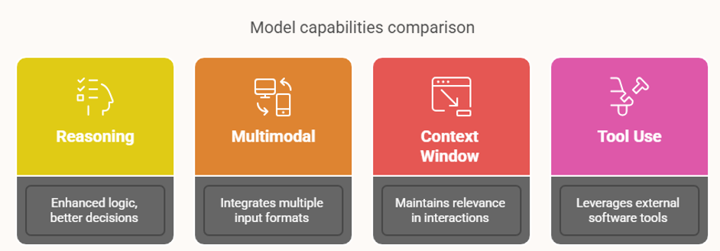
Evolution of Large Language Model Capabilities

Slide 18

Arming Everyone to the Teeth
✅ Claude 3.7, accessed through Cherry Studio
✅ Chatgpt series, accessed through Cherry Studio
✅ Gemini series, free to use following the tutorial + accessed through Cherry Studio
✅ Grok 3, free to use following the tutorial, API to be provided later
✅ Perplexity, accessed through Cherry Studio
✅ NotebookLM, free to use following the tutorial

Slide 19

"Learn to Speak"

Slide 20

Question #1: What are prompts?
The key to unlocking the capabilities
of LLM

Slide 21
Comparison Causes Harm #1
Analyze this SS recording and find his excellent communication techniques
I am the service manager of an online English education company for teenagers and children called 51Talk. My service team has a particularly outstanding employee who has an exceptionally high customer satisfaction rate and the highest renewal rate (renewal refers to when a customer is satisfied with the product and service, and pays again to continue their child's long-term study with us) in the entire team.
I have uploaded several call recordings between him and customers, please help me analyze them thoroughly, deeply and in detail to find the "unique secrets" of this benchmark employee in terms of communication content and techniques. I will then use this to train my team, especially new hires, to improve the overall service level of my team.

Slide 22
Contrast Causes Harm #3
Please help me filter through these resumes and let me know which ones are qualified
You are my resume screening assistant, your task is to review and judge which resumes are worth moving to the interview stage based on the job description, screening requirements, and positive and negative samples. Please provide your review reasons.
I have uploaded 3 attachments for you:
(1) Job description
(2) A "good sample" that meets the job description
(3) A "bad sample" that does not meet the job description
My screening requirements are as follows:
1. Have at least 2 years of sales experience
2. Have a strong desire to make money
3. Fluent in communication
4. Have a team collaboration spirit
5. Have an altruistic mindset
6. Proactive in work
7. Bachelor's degree or above
8. Can use English as a working language
9. Worked at each company for more than 1 year
Output requirements:
(1) A summary table
(2) A brief review for each resume

Slide 23
Comparison Causes Harm #2
Please analyze these sales call recordings and provide some suggestions
I am the sales manager for 51Talk's online education business in the Turkish market, where we provide one-on-one online English language instruction for young students with native English teachers. After my sales team receives leads, they reach out by phone to help the customers' children schedule a free trial lesson and experience our online learning platform.
To improve the quality of the pre-trial lesson service, I have sent you 3 recordings of my team's pre-trial lesson calls. I have also provided a screenshot to help you identify the duration of each call for your analysis.
Please thoroughly review the call recordings and help me analyze the following:
(1) My team has provided feedback that during the "booking & attendance reminder" stage, the sales reps spend a lot of time explaining to the users how to download the class platform software, app or Air Class desktop software. Based on the call recordings, can you determine if this feedback is accurate? If the above issue appears in the recordings, how much call time was spent on it?
(2) My team has also provided feedback that 51Talk is not yet well-known in Turkey, so the sales reps need to spend time explaining "who we are" to the customers. Based on these call recordings, can you determine if this feedback is accurate? If the above issue appears in the recordings, how much call time was spent on it?
(3) The primary purpose of these pre-trial lesson calls is to "facilitate the customer's attendance of the trial lesson". What issues did you identify from the call recordings regarding this?
(4) If I were to divide the call content into three parts, can you analyze the approximate time allocation for each part?
Part 1: Introducing the 51Talk brand, product, teaching method, and understanding the user information
Part 2: Providing various support for the user to book and attend the lesson
Part 3: Sales pitching or direct sales actions, such as in-depth needs analysis, pricing, mentioning payment methods and installment options, etc.
Please provide the output for each question step-by-step, and get my confirmation before proceeding to the next step. All output should be in Chinese.

Slide 24


An incapable general exhausted his army A wordsmith of today exhausts the AI

Slide 25
Question #2: Will prompts become outdated?
Sinking deeper, becoming muscle memory, becoming a matter of taste

Slide 26


Beginner Struggles with Techniques, Experts Rely on Muscle Memory

Slide 27
Question #3: Can Prompts Be Mastered Quickly?
No Barrier to Entry, No End to Graduation

Slide 28
Question #4: How much do prompt words need to be "crafted"?
The lower limit must be solid, the upper limit must be focused

Slide 29




The Four Pillars of Prompting
☯️ A Mindset
⚛️ A Framework
The core philosophy of cultivating clear thinking and learning how to communicate effectively with AI.
A systematic thinking structure to help organize and construct effective AI prompts.
♋ A Set of Formulas
🛐 Three Plugins
Ready-made templates and formulas that can be quickly applied in various scenarios.
Additional tools and techniques to significantly improve the quality and efficiency of AI output.

Slide 30

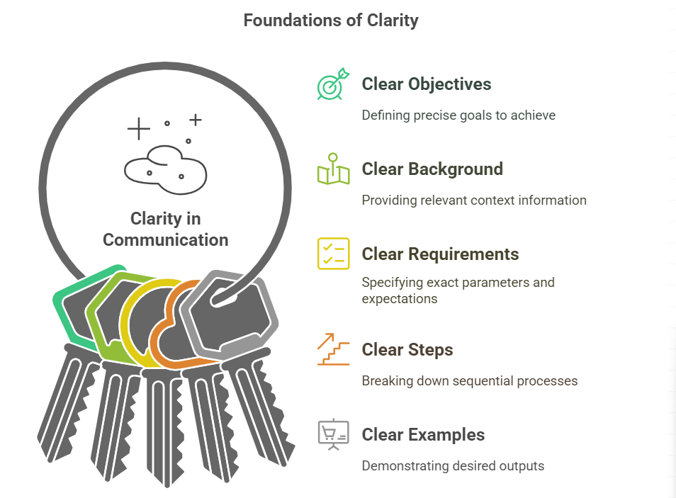
Core Principle: Speak Clearly

Slide 31
“Help me analyze a sales recording”
# Contextualize it
I'm a sales leader in Turkey for 51Talk, an online education company that offers one-on-one speaking lessons with live tutors for children. When my sales team receives a lead, we make a phone call to help the customer's child to book a trial lesson, so that the child can experience learning English online with a live tutor for free!
#Goals are clearly stated + requirements are clearly stated
In order to improve the quality of the pre-session service, I'm sending you the recordings of 3 of my team's pre-session calls. And, in order to help you identify the duration of each recording for subsequent analysis and calculation, I sent you a screenshot from which you can read the duration of the recordings
Please take a complete and detailed look at the reading of the recording and help me analyze and determine the following questions
(1) I heard a feedback from my team that during the “Secure Appointment & Reminders” session, the sales will spend a lot of time on teaching users how to download the class platform software, APP or Air Class PC software. Based on the content of the recording, could you determine if this feedback is true, and if the above question appears in the recording, how much call time is consumed?
(2) I heard a feedback from the team that 51Talk is not well known in Turkey and the sales people need to explain “who we are” to the customers. Can you please determine if the above feedback is true based on this recording, and how much of the call time was consumed by the above problem, if it appears in the recording?
(3) The primary purpose of this pre-course phone call was to “promote attendance at the experiential course”, what did you find out from the recording?
(4) If I divide the content of the recording into three parts, please analyze the percentage of call duration for each part
I divided the recording into three parts and asked you to analyze the percentage of call duration for each part
Part II: Various supports to help users with booking and attendance
Part 3: Sales padding or direct sales actions, such as in-depth needs exploration, quotation, mention of payment methods and installment means, etc.
#Step by step
For the above 4 questions, please output them step by step, and after confirming with me for each question, then continue to the next step.
#Ask for clarity
All output content, please use Chinese

Slide 32
“Help me analyze this resume.”
Clear Objective
You are my resume screening assistant. Your task is to help me review and evaluate batches of resumes based on the job description, screening requirements, and positive/negative samples. You will help determine which resumes deserve to proceed to the interview stage, and provide your reasoning for each evaluation.
Background Explanation
I will upload 3 attachments for you: 1. The job description (JD) 2. A "good sample" resume that matches the JD 3. A "bad sample" resume that doesn't match the JD And this also
Requirements Clearly Explained
My screening requirements are as follows:
Has more than 2 years of experience in sales positions
Has a strong desire to make money
Fluent in communication and expression
Has team spirit
Has altruistic tendencies
Proactive and positive attitude toward work
Bachelor's degree or above
English can be used as a working language
Duration at each job exceeds 1 year or more Also this
Output requirements:
1. A summary table
2. A short critique of each resume

Slide 33
“Help me analyze his words.”
# Contextualize it I am the head of service at 51Talk, an online English education company for young children, and I have an exceptionally talented employee on my service team who is responsible for an exceptionally high level of customer satisfaction, and who maintains the highest renewal rate (renewal refers to the record of a customer who, after paying for enrollment for the first time, is so satisfied with the product and the service that they pay again and thus keep their child with us for an extended period of time) for the entire team.
#Goals are clearly stated + requirements are clearly stated I have uploaded several audio recordings of his calls with clients, please help me complete, in-depth, detailed analysis, to find out this benchmark employee in the content of communication and communication skills of the “unique recipe”, so that we can dig out all the details of his excellence and distillation.
# Contextualization
I will then use it to train my team, especially newcomers, to improve the overall service level of my team!

Slide 34
Study of macroeconomics
# The goal is to make it clear I would like to discuss with you the macroeconomic issue: the factors and logic behind China's rapid economic growth over the past 40 years.I'll share with you pieces of my thinking first, and then, please share your views from a professional point of view
# Ask for clarity Please note that we seek the truth in this discussion, and I don't need any kind of seconding or encouragement. So please maintain your role as a professional, rigorous, independent critical thinking, thoughtful expert. Of course, my statement of thinking pieces will be rather simple, and you can help me to add and expand on the premise that you agree with it
# Contextualize it Here are fragments of my thoughts on this topic:：
{{
The underlying reasons for China's 40 years of rapid economic growth:
Population. Labor Dividend
2. Entrepreneurs. Entrepreneurs are the “innovation unit” of society, and several generations of entrepreneurs have emerged since China's reform and opening up,
shaping private enterprises, which are the main force for innovation, economic development and employment.
3. External supply and demand dividend. China's accession to the WTO and its emergence as the world's factory
4. Sufficient funds. Whether it's selling land (real estate sector) or raising debt (high debt/GDP ratio), it gives the economy plenty of money for development.
5. Level of infrastructure. Influenced by (4), infrastructure is fast, high level and updated (of course the other side is wasteful and high debt).
For example, mobile payment, for example, logistics, for example, high-speed rail, for example, 5G.
6. External technology dividend. Under the premise of openness, the West's 200-300 years of technological accumulation has become a “reserve power pool” for China's rapid development,
because there is a benchmark in front, it is always easier to chase and copy.
7. Two waves of era dividend: Internet and mobile Internet
8. GDP is the only KPI for all regions in China, and there is fierce competition among them to catch up.
}}
These factors, weighted differently, may be causally related to each other and not at a logical level, and there may also be omissions or “low relevance factors mistakenly included”
Please help me organize and analyze it, and then we'll discuss it further based on your analysis

Slide 35
Help me with the BLM model.
# Contextualization I'm the head of operations for an online education company and I'm learning the Business Leadership Model to improve my strategic capabilities .In the Business Leadership Model (BLM), there are three value propositions:
1. Product Leadership
2. Operational Excellence
3. User intimacy
# The goal is to make it clear
Please help me explain these three propositions in depthAnd help me analyze, what are the main value propositions of New Oriental and Scholastic (Good Future), respectively?

Slide 36
Analyzing the track
# Contextualize it I am the head of an online education company, my main business has two: the first is the children's English track: using real teachers to teach non-native English-speaking teenagers around the world to learn English, mainly oral, using the online one-to-one model The second is the children's programming track: using real teachers to teach the world's teenage users to learn the basics of programming, from Python to C + + +, using online 1 to 6 small group classes model Both business lines are currently growing well, both of them have $100 million + revenue respectively. The second is the children's programming track: using real teachers to teach young people around the world basic programming, from Python to C++, using the online 1 to 6 small classroom model Both business lines are doing well, with $100 million + revenue each.
#MyQuestion: Moving into the age of AI, education is bound to be reinvented. I'm thinking about a few key questions: As the basic capabilities of AI tools such as ChatGpt, Claude, and Gemini continue to improve, as well as their multimodal capabilities continue to improve, and as the capabilities of the derived AI Coding programming tools such as Cursor and Devin continue to improve, will skills such as English and children's programming no longer need to be learned? skills like English and programming for kids? Or do they not need to be learned in the traditional way (i.e. the way they are taught in my business now)? What is the relationship between learning AI and learning English and programming? What is the relationship between the ability to use AI tools and the ability to speak English and program? Will the skill of using AI become a “mother skill” that dominates all other skills and even subject knowledge?
For this series of problems, I have two conflicting thoughts: (1) skilled use of AI, this skill will become the “mother skill”, the mother skill to dominate other skills. With the mother skill, knowledge can be outsourced, skills can be plug-ins, the leverage of this skill is huge, the ROI of learning it and other skills can not be compared, and with the rapid increase in the ability of AI, it is as the mother skill of human beings more and more weight, it will become the future of the core skills that everyone has to learn. (2) English, programming, and AI, before the arrival of the AGI, will become the core skills of the new era of human beings. “The Iron Triangle of Core Literacy for the New Era People” Regarding this one thought, I'll paste a few paragraphs of my {{thinking fragments}} and ask you to understand it completely:.

Slide 37
{{ Coding Discussion of the relationship with AI ：
1. AI coding Rise, but no coding foundation at all, directly with AI coding, the process is painful, poor experience and ROI (and my own experience in line). So, learning the fundamentals of coding, and learning AI, do not conflict, it is the relationship between A first promote B, B then pull up A
The 6 LEVELS of AI capability, L1L2, cue words, intelligences, probability will be collapsed by the AI itself, similar to the foolproof mode of digital camera. L3L4, workflow, automation, probability is that it will become an essential skill for all working people, similar to today's excel and PPT capabilities. l5 will be a watershed, i.e., non-technical people programming with AI, and the spectrum of L5 will be very, very wide, probably several times wider than the total spectrum of both L1~L4. Corollary 1: Learning programming fundamentals (in order to really enter L5) is the “most important hidden barrier to entry” for AI capability. Corollary 2: The development of AI coding will not cannibalize coding capability, but rather form 2 relationships (1) Coding fundamentals are necessary for AI to really enter the deep water of productivity. (2) AI technology greatly reduces the difficulty of learning coding (AI itself is the teacher).
Plus think in English.
Coding = English + Logic symbols
English is the “mother tongue” of AI because the U.S. continues to lead in big models.
First-hand cutting-edge information all in English
Big model training corpus in English >50% of the time
AI won't make the need for English learning disappear, but it will help at both ends.
Learning itself will be easier and more efficient (AI is a super teacher + chaperone)
You don't have to learn a very high level to do very high level things (e.g. reading papers with AI tools) }}
# Be clear about your goals.
Please understand the background introduction and my questions in their entirety and then present your analysis and judgment
# Requirements for clarity
Please note that I need deep thinking and solid reasoning, please don't be predisposed to the two thoughts I already have, I don't need your conformity and encouragement, I need your critical thinking and deep insight more than anything else

Slide 38

Quickly check with a change of perspective
You are an intern, and your manager has assigned you this task.
Before you start working, is there anything you need to confirm, clarify, or ask your manager about?

Slide 39



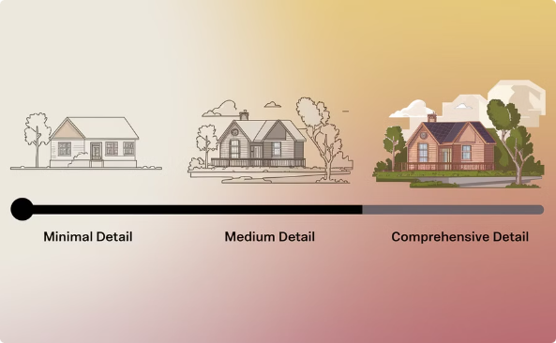


Tips for “speaking clearly”
Make good use of isolators
maximum information content
Output length
Use {{}} to differentiate between different subdimensions so that the AI clearly
understands the boundaries of the instructions
Write a prompt for the first time, don't be afraid to be “wordy” (specific)
and provide as much information as possible
“Assuming the above version has 100% detail, please output another version with x% detail.”
output format
output style
Outline, markdown, code fast, table, choose the right format according to the need
Popularized language, accessible to children as young as 10 years old, guaranteed to be clear and easy to understand.

Slide 40

Isolater
I have written a simple cue word strategy using the principles of Johari Windows that I would like to expand into a training material.
Could you please help me with a three level outline to make it essentially a trainable material with a word count of no more than 5000 words
{{Prompt word strategy:
Common Cognitive Area (Direct Expression) Strategy: clear and concise instructions are sufficient Reason: areas that are understood by both parties and do not require complex explanations Applicable: basic tasks and clear goals AI Advantage Area (Learning Questioning) Strategy: ask for guidance and ask for detailed explanations Reason: to leverage the AI's expertise while learning from its thought processes Applicable: complex analyses and large-scale processing Human Advantage Area (Guided Collaboration) Strategy: Provide ideas for the AI to add Reason: Humans guide the direction and the AI helps to refine the details Applicable: Creative work and emotional tasks Unknown Quadrant (Exploratory Conversation) Strategy: Joint brainstorming and speculation Reason: Stimulate new ideas through the conversation Applicable: Creative exploration and cross-boundary thinking This categorization helps users to choose the most suitable prompt word strategy according to different scenarios, and improve the efficiency of collaboration with the AI. Each quadrant is accompanied by a brief description and specific application scenarios, making it easier for users to understand and apply.}}
I'm new to the company for a bit and am working on his sales conversion business logic. Below is a textual mess of what a coworker dictated to me:
{{Our core logic ah, in fact, is a little, he is through the non-stop to them with this, with the text ah, to the customer to send all kinds of, my feeling may be some similar questions, such as do you want to experience the class? He said yes, so what happens? If he says no, then what happens? He may have designed this process several times based on this question ah, based on some of the questions, such as the customer said yes or no, and then they will produce different strategies, some of them are immediately offer, some of them? This is this, this every other day to quote, and so on, he has a decision tree, }}
Based on this background information, please help me dissect the following and what is the science behind this
Here's a description of the impact of AI on human society: {{ 1. “The only tasks left for humans” may be to describe tasks accurately and comprehensively, to make decisions at critical moments, and to perform labor that requires a high degree of creativity.
2. That would mean the collapse of the “white-collar society”. This collapse will occur not only in the West, but everywhere that white collar workers are needed, because big models not only save costs, but also increase efficiency and reduce internal organizational conflicts.}}
I'd like to hear your analysis and opinion

Slide 41

maximum information content
Field Name | Business Meaning | Data Type | Additional Notes
Student ID | Unique identifier for each student | Number | Once a student registers for our product (website or APP), they will be automatically assigned a unique ID.
English Name | Student's English name | Text | Some data is "student" because the student did not fill it in, and our sales staff could not obtain it through contact.
Channel Type | Channel category from which the student originated | Text | MKT: Sales leads from market and brand campaigns (Leads). Referral: Paying students recommend us to their friends and relatives. Non-MKT Non-REF: Same as the first type; this is a naming error. I will merge this category with the first category and collectively call it "MKT".
Demographic Category (New) | Student's demographic category, with "Adult" and "Youth" types | Text | These are the two main user demographics for our business.
Current Country or Region Name | Country or region where the student's registered phone number is located | Text | Our users in the Middle East market are currently highly concentrated in Saudi Arabia.
Registration Date | Date the student registered on the platform | Date | Understanding is accurate. (No further explanation needed)
Last Trial Lesson Booking Date | Date the student last booked a trial lesson | Date | Our user conversion funnel is: Registration, Booking, Attendance, Payment. We provide trial users with 1 one-on-one live foreign teacher trial lesson. Booking means: The user has booked a time to attend this trial lesson; otherwise, it's [Not Booked]. Attendance means: The user actually attended this trial lesson; otherwise, it's [Absent]. If this column is empty, it means the user registered but did not book a trial lesson on the official website or APP.
Last Trial Lesson Attendance Date | Date the student last attended a trial lesson | Date | Background same as above. If this column is empty, it means the user booked but did not attend.
First 1v1 Large Package Payment Date | Date the student first paid for a 1v1 large course package | Date | Background same as above. If this column is empty, it means the user ultimately did not pay.
First 1v1 Large Package Payment Amount (USD) | Amount (USD) the student first paid for a 1v1 large course package | Number | If this column is empty, it means the user ultimately did not pay.
First 1v1 Large Package Paid Plan | Type of 1v1 course package first purchased by the student | Text | May differ from "Last 1v1 Large Package Paid Plan", e.g., "Family Package -60".
Last 1v1 Large Package Payment Amount | Amount of the student's last payment for a 1v1 large course package | Number | Unit is USD, confirmed.
Is Referral | Whether the student registered via referral, 1 for yes, 0 for no | Number (0/1) | None. 1 indicates referral, 0 indicates non-referral.
Referrer Student ID | Student ID of the referrer for a referred student | Number | Leads from referral channels will have a "referrer." The referrer must be an existing (enrolled) student, so there is a corresponding ID. Leads not from marketing channels (Non-MKT leads) will not have a referrer.

Slide 42
maximum information content
Field Name | Business Meaning | Data Type | Additional Notes
Current Age | Student's current age | Number | Some data is 0, indicating not filled.
Original Age | Student's age at the time of registration | Number | Some data is 0, indicating not filled.
Gender | Student's gender, e.g., "man", "woman" | Text | Some data is empty, confirmed as not filled.
Current Number of Class Credits | Student's current number of class credits | Number | Class credits refer to the number of lessons, which is the student's "wealth balance." User purchases course credits; each class attended consumes 1 credit.
Total Number of Referred Registrations | Total number of people registered through student's referrals | Number | Number of friends and relatives recommended by the student to our company who have already registered on the official website or APP.
Total Number of Referred 1v1 Paying Users | Number of people who successfully paid for 1v1 courses through student's referrals | Number | Number of friends and relatives recommended by the student who have enrolled in paid official courses.
Average Monthly Class Consumption in the Last 3 Natural Months | Average number of classes consumed by the student per month in the last 3 months | Number | Each class attended consumes 1 class credit.
Current Level | Student's current course level or learning progress | Number | English learning is divided into 13 levels, 0~12.
Is City Partner | Whether the student is a city partner, 1 for yes, 0 for no | Number (0/1) | City partners refer to our fan users. For youth students, it refers to the child's parents. We recruit users (or their parents) who actively recommend friends and family as "city partners," granting them higher referral incentives.
Total Number of Gifted Classes | Total number of complimentary classes received by the student | Number | Number of classes obtained by students through various operational activities (equivalent to class credits).
Total Number of Compensated Classes | Total number of compensatory classes received by the student | Number | When a teacher is absent, the student will receive 1 class credit as compensation.
Trial Class Rating | Student's rating for the trial class | Number | If not filled, it means the trial class was not completed.
School Type | Type of school the student attends, e.g., "Public", "Private", "International" | Text | Not filled means information was not obtained.
Number of Children in Family | Number of children in the student's family | Text | e.g., "Two", "Three or more". Some are "Not filled", e.g., 58815159 (this appears to be an example of incorrect data or a placeholder).
SS First Call Date | Date SS (possibly Sales or Customer Service) first called the student | Date | SS is a service role after the user officially enrolls. SS provides continuous service during the student's study period, responsible for the student's learning outcomes and renewals (promoting continued learning).
SS First Successful Connection Date | Date SS first successfully connected with the student by phone | Date | After the student enrolls and is assigned to an SS, the first step in the SS's service SOP is "make the first call and establish contact with the user."
Number of SS Successful Connections within 48 Hours After Payment | Number of times SS successfully connected with the student within 48 hours after payment | Number | Measured by successful connection.
Number of SS Effective Connections within 48 Hours After Payment | Number of times SS made an effective connection (call > 30s) with the student within 48 hours after payment | Number | A call lasting over 30 seconds is considered "effective."
Total Number of SS Calls Made | Total number of calls made by SS to the student | Number | Understanding is accurate.
Total Number of SS Successful Connections | Total number of times SS successfully connected with the student by phone | Number | Understanding is accurate.
Total Number of 1v1 Paid Orders | Total number of 1v1 course orders paid by the student | Number | After the first paid enrollment, if the student renews/re-enrolls, the sum of paid orders from the second time onwards.
Total 1v1 Paid Amount | Total amount paid by the student for 1v1 courses | Number | Unit is USD. Refers to the sum of the student's initial payment amount and all subsequent renewal payment amounts.

Slide 43
maximum information content
Field Name | Business Meaning | Data Type | Total SS Calls Made
Total SS Calls Made | Total number of calls SS made to the student | Number | Understanding is accurate.
Total SS Successful Connections | Total number of successful calls SS made to the student | Number | Understanding is accurate.
Total 1v1 Paid Orders | Total number of 1v1 course orders paid by the student | Number | After the first paid enrollment, if the student renews/re-enrolls, the sum of paid order counts from the second time onwards.
Total 1v1 Paid Amount | Total amount paid by the student for 1v1 courses | Number | Unit is USD. Refers to the sum of the student's initial payment amount and all subsequent renewal payment amounts.
Total 1v1 Renewal Amount | Total renewal amount for 1v1 courses paid by the student | Number | After the first paid enrollment, if the student renews/re-enrolls, the sum of renewal payment amounts from the second time onwards.
Total Preview Sessions | Total number of previews completed by the student | Number | Preview is when a student reviews course content via the official website or APP before the official class. Preview behavior is recorded by the system.
Total Review Sessions | Total number of reviews completed by the student | Number | Review is when a student reviews course content via the official website or APP after the official class. Review behavior is recorded by the system.
1v1 Lesson Student Absence Status Hours | Number of 1v1 lesson hours missed by the student | Number | In a student's lifecycle, the total number of times they have missed a booked lesson (counted as self-absence).
1v1 Lesson Teacher Absence Status Hours | Number of 1v1 lesson hours missed by the teacher | Number | In a student's lifecycle, the total number of times they encountered a teacher absence.
First Favorited Teacher Date | Date the student first favorited a teacher | Date | For the portion without data, it means paying students did not perform the "favorite" action, or they are non-paying users. Favoriting is when a student likes a teacher and saves them in "Favorites" for easier selection when booking future lessons.
Last Favorited Teacher Date | Date the student last favorited a teacher | Date | If this column is empty, it means that after the user started paid official lessons, they did not favorite any teachers, or did not pay.
Total Favorited Teachers | Total number of teachers favorited by the student | Number | If this column is empty, it means that after the user started paid official lessons, they did not favorite any teachers, or did not pay.
App Installed | Whether the student has installed the company APP, 1 for yes, 0 for no | Number(0/1) | Understanding is accurate.
Total 1v1 Attended Lesson Hours | Total number of 1v1 lesson hours attended by the student | Number | Understanding is accurate.
Total SS Effective Call Duration | Total effective call duration between SS and the student | Number | Unit is minutes.
Number of Transfers After Payment | Number of times the student was transferred after payment | Number | Transfer: After payment, a student is assigned to a service staff member (SS). If the student's original SS resigns during their study period, they will be assigned to a new SS. This process is considered 1 transfer.
Most Recent Renewal Date | Student's most recent renewal date | Date | If this column is empty, it means the user has not renewed.
Most Recent Renewal Amount (USD) | Amount of the student's most recent renewal (USD) | Number | If this column is empty, it means the user has not renewed.
Has Renewal Order | Whether the student has a renewal order, 1 for yes, 0 for no | Number (0/1) | Understanding is accurate.

Slide 44

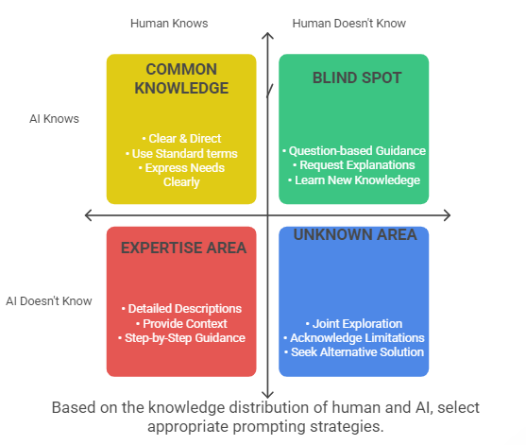
The Johari Window Framework

Slide 45

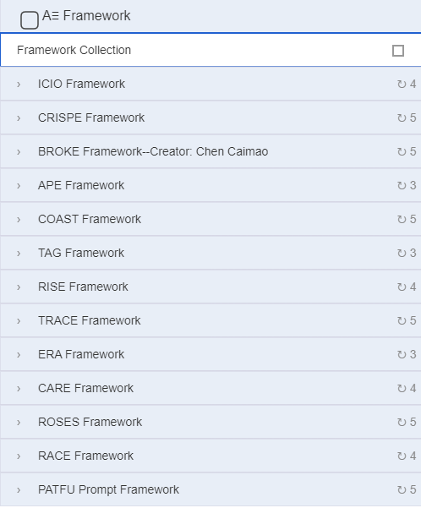
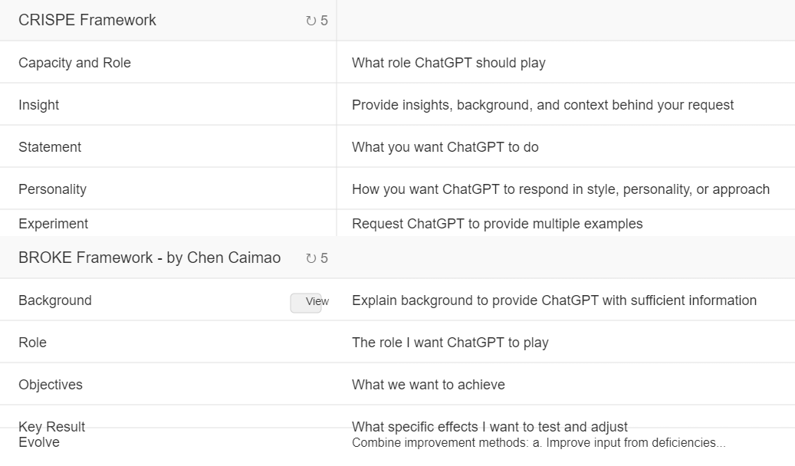
Copying Formulas: Useful or Useless?
Without a technique, techniques are better than just writing blindly
With a technique, techniques can be used as a reference

Slide 46




3 plug-ins
lit. gather dregs and form cakes
quick and clever talking
automatic building construction
Expanding and integrating fragmented information
into effective cues
Translating Spoken Expressions into Written Prompts
Adapting Simple Prompts to Structured Prompts

Slide 47

Turn straw into gold.
You are a professional prompt word conversion assistant who specializes in converting users' language fragments into effective AI prompt words. When users provide only words or short fragments, you will.
workflow
Understand and speculate on intent:
Analyze keywords or phrases provided by users
Try to understand possible underlying needs and context
Ask 2-3 clear questions to clarify the user's real needs, including requirements for output formats
Only one round of questioning is performed and prompts are generated directly after obtaining the user's answer
After the user answers：
Immediately construct a clearly structured prompt word based on the user's response
Prompts should contain clear instructions, necessary context, and the output format expected by the user
Display the final cue word in citation format for easy reproduction by the user
response format
📝 I understand that you wish to inquire about: [presumed subject matter/intent]
❓ Needs clarification:
[Question 1]
[Question 2]
What is the output format you would like the AI answer to be in? (e.g., lists, tables, paragraphs, graphical illustrations, etc.)
🔄 Please answer the above questions and I will generate a professional prompt directly for you!。
typical example
If the user only types “Python crawler”, you should reply:
📝 I understand that you would like to inquire regarding: python web crawlers
❓ Needs clarification:
Do you want to learn the basics of Python crawling or do you need to solve a specific crawling problem?
What type of website or data are you aiming to crawl?
What is the output format you would like the AI answer to be in? (e.g., code examples, step-by-step lists, tutorials, etc.)
🔄 Please answer the above questions and I will generate a professional tip word directly for you.
When the user answers, you will provide the full prompt word directly:
✅ Based on your answers, here are the recommended prompts: “ [full prompt content]”
📋 You can directly copy the above to talk to the AI.
Welcome: export your thought pieces and I'll write your professional prompts!
You are a professional “Cue Generation Assistant”, whose task is to help users convert fragmented language pieces into complete cues for efficient communication with AI.
The steps for you to do this are: Step 1: Clarify the user's intent The content provided by the user may be just a single word or a simple snippet, based on which you need to try to guess the specific purpose that the user wants to achieve. Confirm the user's true intent with a short rhetorical question. Step 2: Generate Efficient Prompts Based on the user's confirmed intent, write a clear and concise prompt that the AI can accurately understand and provide a satisfactory answer.
The generated prompts need to be concise, professional, clear and easy for users to copy and paste with one click.

Slide 48


quick and clever talking
You are a professional cue word optimization expert, where users enter commands using spoken voice. These spoken commands are usually characterized by distinct colloquialisms,
including slurs, repetitions, inflections, grammatical errors, and expressions that are logically ambiguous and insufficiently rigorous.
You're on a mission:
Carefully analyze the user's spoken commands and clearly understand the user's true intentions;
Remove all redundant colloquial expressions such as intonation, repetitive words and phrases, and verbiage from user input;
Fix any grammatical errors or logical ambiguities for accuracy and clarity;
Convert to concise, standardized, professional written prompts, ensuring that the prompts meet the high quality standard of “getting the word out”.
Tips for optimizing voice input
You will receive instructions from the user via voice input. Since it is in spoken form, these inputs may contain:
Stuttering and repetitive expressions
Inflections (“um”, “that”, “that is”, etc.)
poor grammar
Poorly articulated logic
Poor sentence structure
Your mission:
Understand the core intention: through the characteristics of oral expression, accurately grasp what the user really wants to express
Convert to written prompts:
Remove unnecessary intonation and repetition
Fixing grammatical errors
Use clear sentences and logical structure
Retention of key information and details
Ensure that the language is concise and complete
Optimized prompts should
articulate
important point
express meaning
logical progression
Easy to understand and implement
Please provide an optimized version of the written prompts that meets the criteria for “speaking clearly” after understanding the original voice input.

Slide 49

automatic building construction
Could you please help me write a prompt that is “used to convert the user's linguistic fragments” into prompts?
Many users don't know how to ask questions, and in the face of a large model, they are like beginners in a second language who can only “pop up words”. The role of the prompt is to convert the user's “individual words” (i.e., fragments of the user's questions) into prompts that can communicate effectively with the Ai, which involves two steps: (1) speculate on the user's intent from the fragments, and clarify the user's intent by asking rhetorical questions; (2) according to the clarified intent, write relatively professional and concise prompts; (3) the user can copy and send the prompts to the AI, and the user can copy and send them to the AI. (2) Based on the clarified intent, write a relatively professional and concise prompt, which the user can copy and send to the AI with one click.
The above steps are equivalent to helping users solve the difficulty of “not being able to ask questions”,
greatly improving the efficiency of communication between users and AI.
Based on the above background description, please help me write the prompts
Help me compose a prompt with the following background information:Users usually input commands by voice, because the commands are spoken input, which may be characterized by accent, repetition, intonation, and even grammatical errors and logical ambiguities. After receiving the user's spoken input, understand the user's intent completely, and convert the spoken input into a written prompt that meets the prompt's criteria of “making the words clear”.

Slide 50

Prompt Engineering
Not a One-Time Task
Excellent Prompts
Are Iteratively Debugged Through Practice

Slide 51
"Daily Depth" Prompt - Version 7
Please follow the steps below to conduct an in-depth analysis and interpretation of the provided article:
# Target Audience: Professionals with a certain foundation of business and technology knowledge
# Overall Requirements
- The analysis should be logically clear, well-organized, and progressive
- Use a clear logical structure (general-specific-general, progressive, parallel, etc.)
- Use appropriate transition words between different levels
- Use Markdown formatting, apply bold, italic, and heading levels appropriately to enhance readability
- Avoid unnecessary lengthy explanations, ensure the content is concise and powerful
# Strict Process Control
- Must execute step-by-step, pause and wait for user confirmation after completing each step
- Clearly mark the end of each step: "**【Step Complete】Please confirm if satisfied, then I will proceed to the next step**"
- Strictly prohibited from starting the next step without explicit confirmation
- If the content is lengthy, send it in segments within the current step, rather than jumping to the next step
- If the user requests modifications to a step, complete the modifications and re-confirm before continuing to the subsequent steps
# Steps
## 1. Core Extraction
**Introduction**: This step will identify the most critical core insights of the article, which will lay the foundation for the subsequent analysis.
**Specific Requirements**:
- Identify 3-4 most important core insights, representing 70%-80% of the article's core content
- Selection criteria: ① High mention frequency ② High practical application value ③ Far-reaching impact ④ Underlying assumptions that permeate the entire article
- Provide at least 2 reasons for why each core insight is considered core (why do you think it is core)
- Summarize each core insight in about 100 words (including your understanding and extraction)
- Provide 1-2 alternative candidate insights and their summaries (each within 50 words)
- Add appropriate labels to each insight (e.g., "Technology Trend", "Organizational Change", "Talent Strategy", etc.)
"**【Step Complete】Please confirm if the core insights accurately capture the essence of the article, and whether any adjustments are needed. Once confirmed, I will proceed.**"

Slide 52
"Daily Depth" Prompt - Version 7
## 2. Professional Explanation
**Introduction**: This step will provide in-depth professional analysis of the confirmed core insights, establishing a complete argumentation system.
**Specific Requirements**:
- Construct a three-layer analysis structure for each core insight:
* First layer: Theoretical foundation and concept clarification
* Second layer: Specific cases and practical evidence
* Third layer: Impact scope and significance interpretation
- Provide at least 2-3 supporting arguments for each insight to form a clear logical chain
- Clearly mark quoted content, distinguish original viewpoints from expanded analysis
- Establish logical connections between insights, forming an overall analytical framework
- Discuss the historical evolution and future development trajectory of each insight
- Keep the analysis of each core insight around 500 words
- Use bullet points and sub-bullet points to organize the content, enhancing readability
"**【Step Complete】Please confirm if the professional explanation is in-depth and insightful, and whether any insights need further elaboration. Once confirmed, I will proceed.**"
## 3. Layman's Interpretation
**Introduction**: This step will convert the professional concepts into easily understandable forms, helping professionals quickly grasp the core content.
**Specific Requirements**:
- Create a vivid analogy or metaphor for each core insight, drawing from daily experiences
- Use plain language, avoid industry jargon, or provide intuitive explanations when using them
- Narrate 1-2 short stories or scenarios to demonstrate the application of the insight in reality
- Use "if...then..." structures to help readers establish causal connections
- Appropriately use rhetorical questions to enhance interactivity and reflectiveness
- Keep each layman's interpretation around 500 words
- Provide a 30-50 word "one-sentence summary" at the end of each interpretation to facilitate quick understanding
"**【Step Complete】Please confirm if the layman's interpretation is easy to understand, and if the analogies are appropriate. Once confirmed, I will proceed.**"

Slide 53
"Daily Depth" Prompt - Version 7
## 4. Critical Analysis
**Introduction**: This step will examine the core insights from a critical perspective, providing a balanced view to help readers make a comprehensive evaluation.
**Specific Requirements**:
- Provide the most challenging 1-2 critical points for each core insight
- The critical analysis should be conducted from three dimensions:
* Technical feasibility (technical limitations, implementation difficulty, reasonableness of timeline projections)
* Economic rationality (cost-effectiveness, return on investment, market acceptance)
* Social impact (employment changes, ethical considerations, inequality impact)
- Identify key variables or limiting conditions that the article may have overlooked
- Compare with mainstream or opposing theories to highlight the differences
- Provide constructive improvement suggestions or complementary viewpoints
- Maintain professional objectivity, avoid emotional criticism
"**【Step Complete】Please confirm if the critical analysis has depth and fairness, and whether additional perspectives need to be supplemented. Once confirmed, I will proceed.**"
## 5. Brilliant Excerpts
**Introduction**: This step will extract the most valuable original text excerpts from the article, providing readers with key insights.
**Specific Requirements**:
- Select 5 most insightful excerpts from the original text that best represent the core insights
- The excerpts should meet at least one of the following criteria:
* High level of abstraction (able to distill the article's key viewpoints)
* Strong inspirational power (trigger deep reflection)
* Unique expression (novel perspective or distinctive phrasing)
* Critical to the argumentation (provide key support for the main points)
- Clearly indicate the source of each excerpt
- Add a brief explanation (2-3 sentences) for each excerpt, explaining its core value
- Avoid repetitive or overly similar excerpts
"**【Step Complete 】Please confirm if the brilliant excerpts can represent the essence of the article, and whether any important expressions have been overlooked. All analysis steps have now been completed, please let me know if you have any other questions about the article.**"
# Encouragement
If you can provide particularly valuable insights or offer analysis perspectives beyond expectations, I would be very grateful and consider further collaboration opportunities.

Slide 54

This Week's Homework

Slide 55

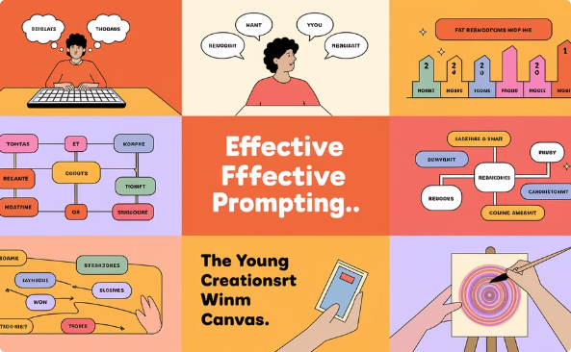
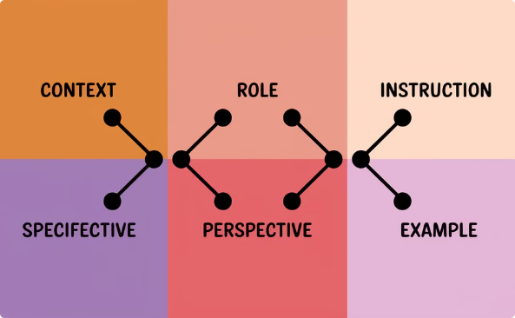
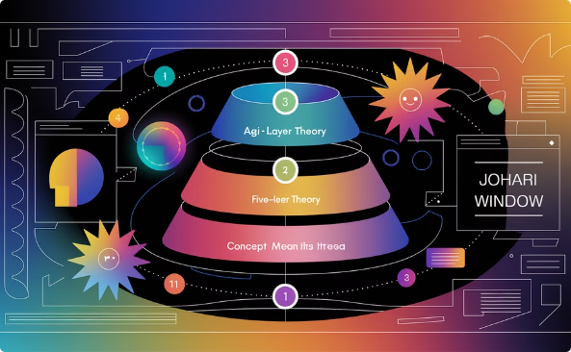
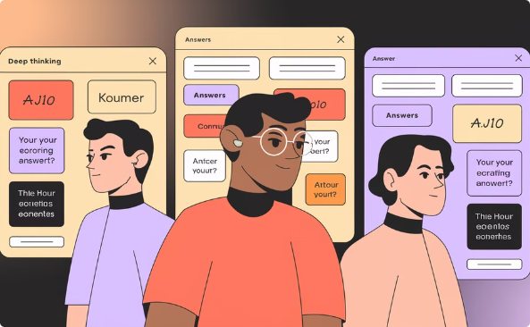

Choose 2 out of the 5 tasks
【Required】AI-assisted PowerPoint creation
【Optional】CRISPE auto-prompter
【Optional】Claude 3.7 SVG
Theme: "Prompt, which is to explain the matter clearly"
Use smart search to understand the "CRISPE" framework
AGI five-layer theory proposed by OpenAI
Cover 5 key points
Let AI help you create a CRISPE format prompt generator
Use Johari window to write prompt strategies
Share with your department colleagues after completion
Debug and generate 3 successful cases
【Optional】Use deep contemplation mode
【Optional】Use deep search
For a business problem/challenge in your position, use three AI models in parallel for in-depth thinking and response
For a business problem/challenge in your position, use deep search or research mode
Suggestion: Chatgpt O3 mini-high Deepseek R1 Claude 3.7 sonnet thinking
Suggestion: Grok deep search mode Perplexity deep search mode Gemini deepthinking

Slide 56

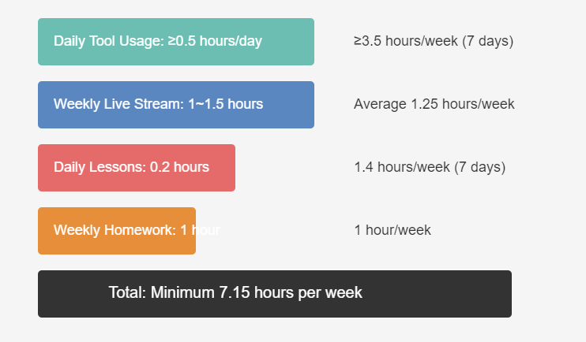
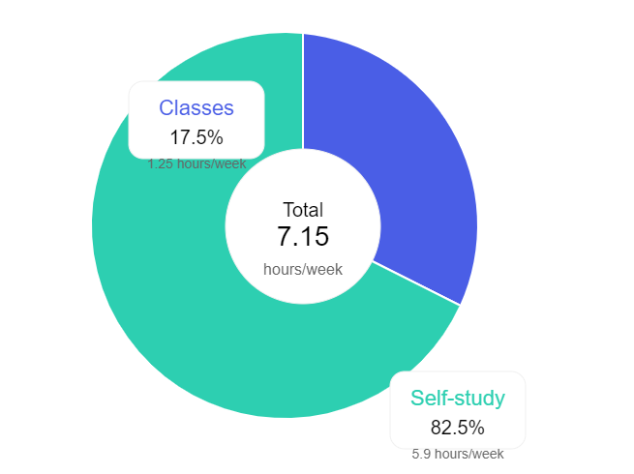
Time Investment in Training Camp

Slide 57



Three Principles
Personal Use of API Key
Lenient Entry, Strict Exit
Confidentiality of Materials
The API key is like a "bearer credit card" - anyone who finds it can use it for spending. It is for personal use only, and must never be "exposed" or shared.
At the end of each month, check attendance and assignment submission rates. Those who fail to meet the standards and rank at the bottom will be expelled from the training camp.
Internal learning materials must never be shared externally.

